Slide 1
CS 360 Presentation Sept. 26
Andrew Plum and Nathan Nguyen

Slide 2
Our Project: Improving NoDD
NoDD is an interactive learning tool provided within Project 360
NoDD stands for Normalization and Database Design
We plan to expand upon the already existing NoDD interactive web framework.
We will be implementing the evaluation algorithm which grades student responses concerning the normalization of functional dependencies.

Slide 3
Functional Dependencies and Normalization
Functional dependencies
These are a key concept in database design.
When the values of some attributes in a database uniquely determine the values of other attributes in the database, we say they are functionally dependent.
Example: A --> B and B --> C, then A --> C
A database contains attributes "Date of birth" and "Age" and "Is minor"
"Date of birth" --> "Age"
"Age" --> "Is minor"
Therefore "Date of birth" --> "Is minor"
Normalization
Is the process of organizing data in a database in order to reduce ambiguity, redundancy, and ensure consistency.
There are two main normalization algorithms that exist for functional dependencies: the 3NF algorithm and the BCNF algorithm.

Slide 4
Project Steps
Connect with app interface for inputs
Interpret data
Structing
Implement algorithm
Evaluating for 3NF and BCNF
Output data

Slide 5





Software and Tools
Programming Languages Used
We're considering using:
php
Python
Development Tools
Some options include:
Visual Studio Code
Git/GitHub
Notepad++

Slide 6
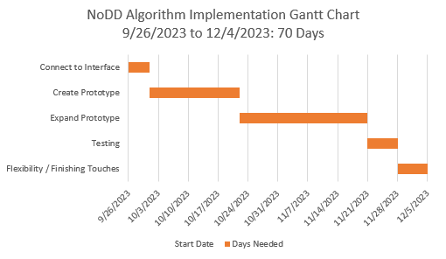
Schedule

